Slide 1
Materials:
Small notecard
Blank paper
Ruler
Pen or pencil
Determine the length, width, and area of the notecard

Slide 2
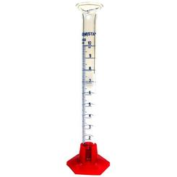
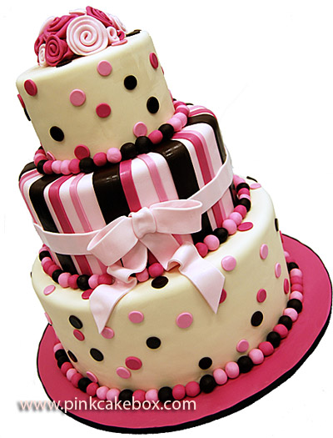
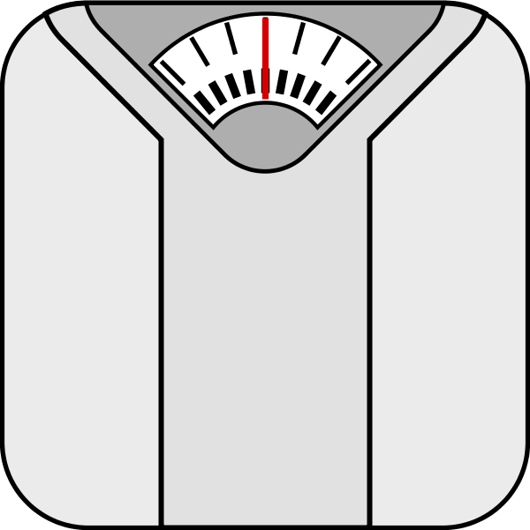
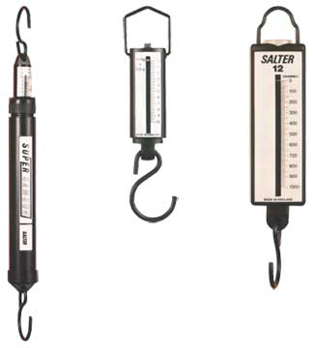
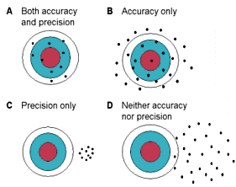
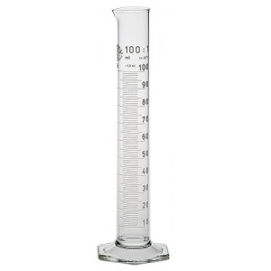
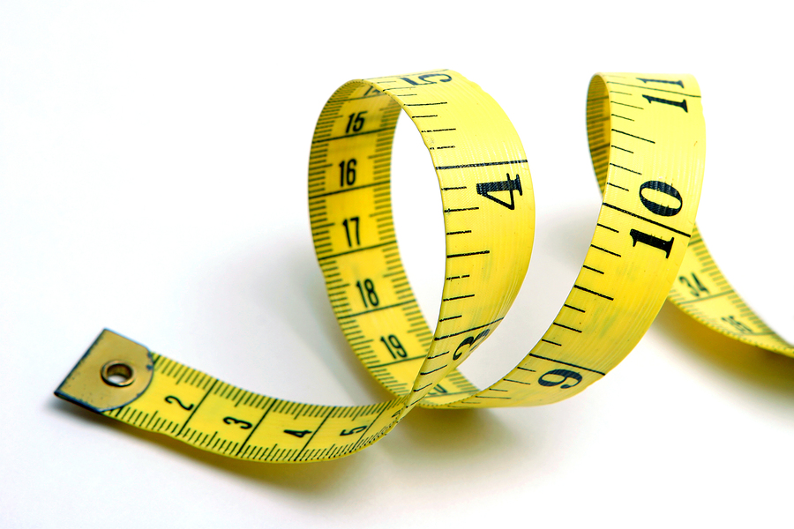

Slide 3
Redo measurements

Slide 4
So What?
Units: metric system vs US system
Precision: number of decimal places
Significant figures

