Slide 1
Life in the Ocean
12

Slide 2
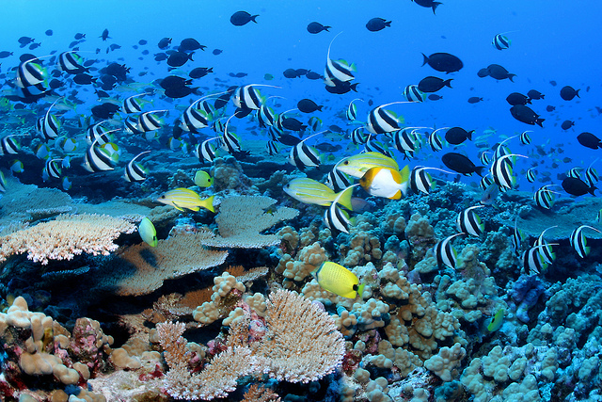
Life on Earth Is Notable for Unity and Its Diversity
Diversity
Earth may house as many as 100 million different species (kinds) of living organisms
Unity
In a sense, all life on Earth is fundamentally the same—it’s just packaged in different ways

Slide 3
The Concept of Evolution Helps Explain the Nature of Life in the Ocean
Natural selection
Darwin’s and Wallace’s theory of evolution
Mutation: an inheritable change in an organism’s genes
Adaptations: beneficial inheritable structural or behavioral traits
Species: a group of actually (or potentially) interbreeding organisms

Slide 4
The Concept of Evolution Helps Explain the Nature of Life in the Ocean (cont’d.)
Convergent evolution
Environmental conditions lead to similar adaptations in otherwise much different species
The environment isn’t right for the organisms; rather, the organisms are right for the environment

Slide 5
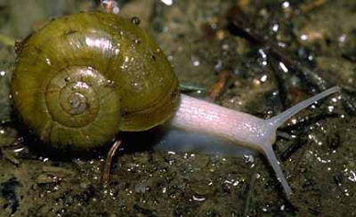
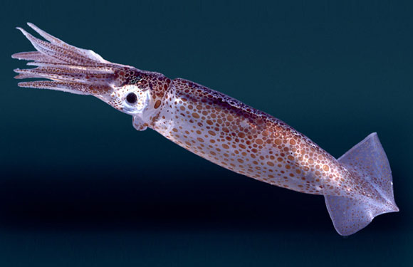
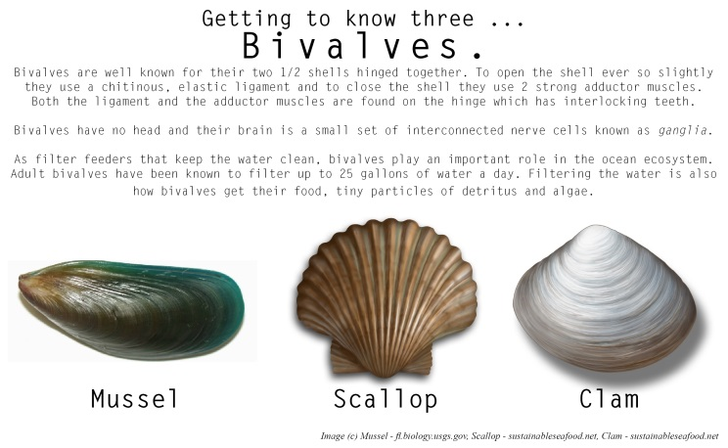
Oceanic Life Is Classified by Evolutionary Heritage
Natural system of classification
Common natural origin
Linnaeus: father of modern taxonomy
Kingdoms and hierarchies
Notes:
Kingdom: animal
Phylum: Mollusc → meaning soft body. How do all of these organisms fit into that phylum
Class: Bivalve, Gastropod, Cephalopod
Shared common ancestors. Through natural selection driven by mutations, independent assortment they evolve.

Slide 6
Oceanic Life Is Classified by Evolutionary Heritage (cont’d.)
Bacteria and Archaea
Small, single-celled organisms with no distinct compartments
Eukarya
Usually multicellular with nuclei and organelles
Animals, plants, fungi, and protists

Slide 7
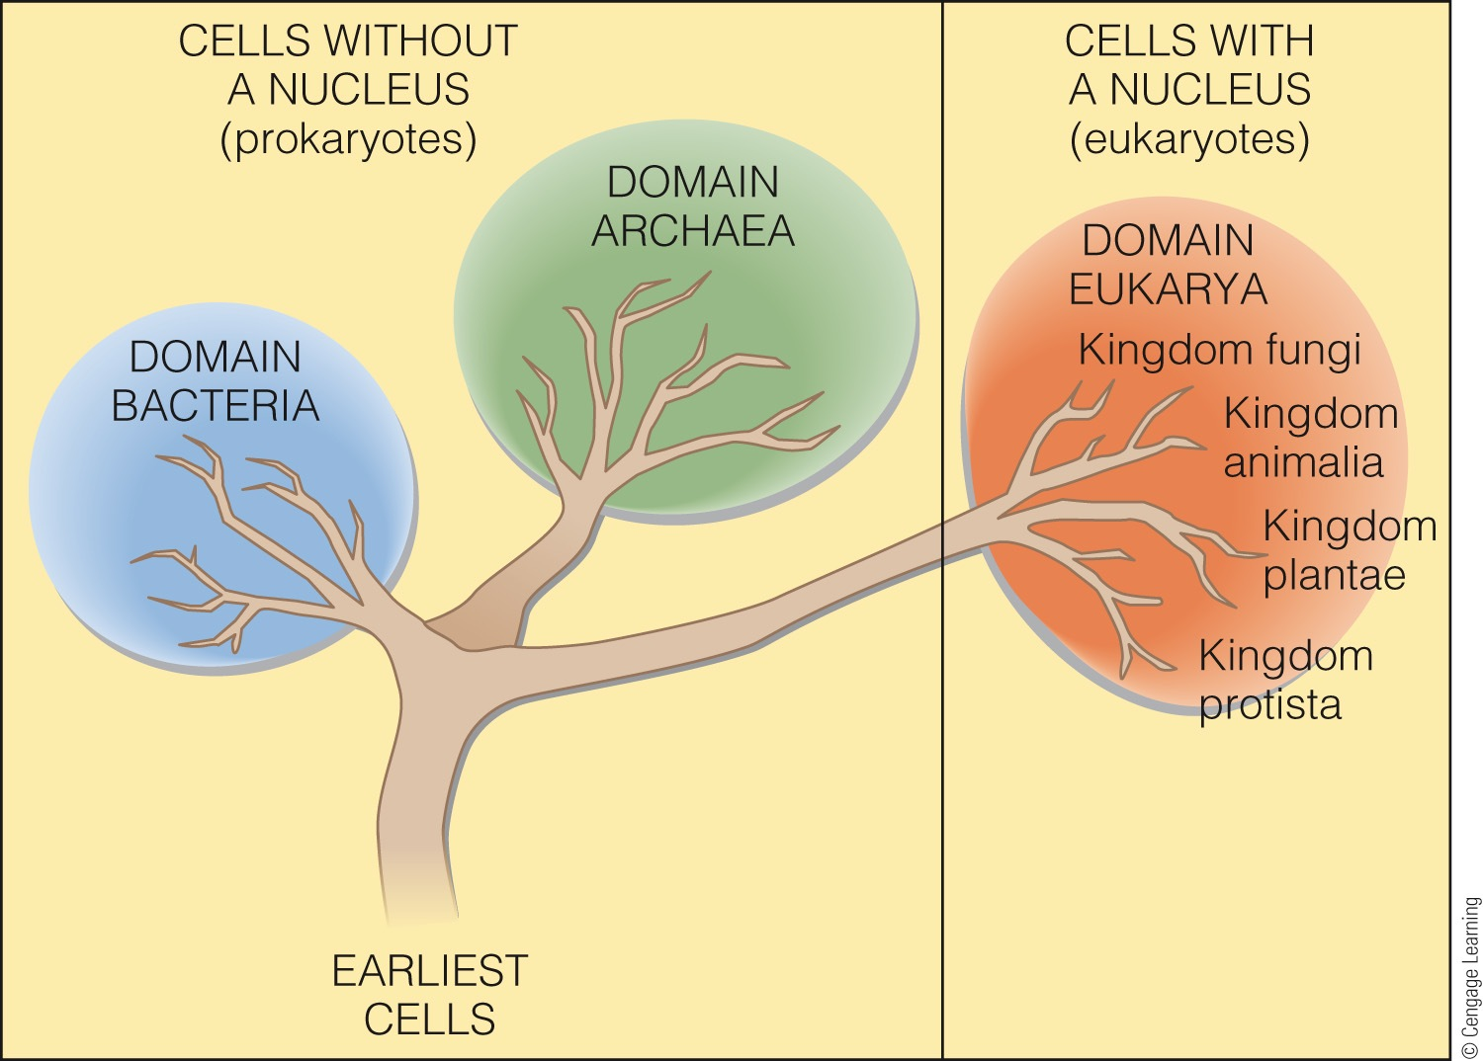
Three Domains of Life
Notes:
Figure 12.6 A family tree showing the relation of the three domains of living things presumably evolved from a distant common ancestor. The Bacteria and Archaea contain single-celled organisms without nuclei or organelles; collectively, they are called prokaryotes. The fungi, protists, animals, and plants contain organisms with cells having nuclei and organelles; collectively, they are called eukaryotes.
© Cengage Learning 2015

Slide 8
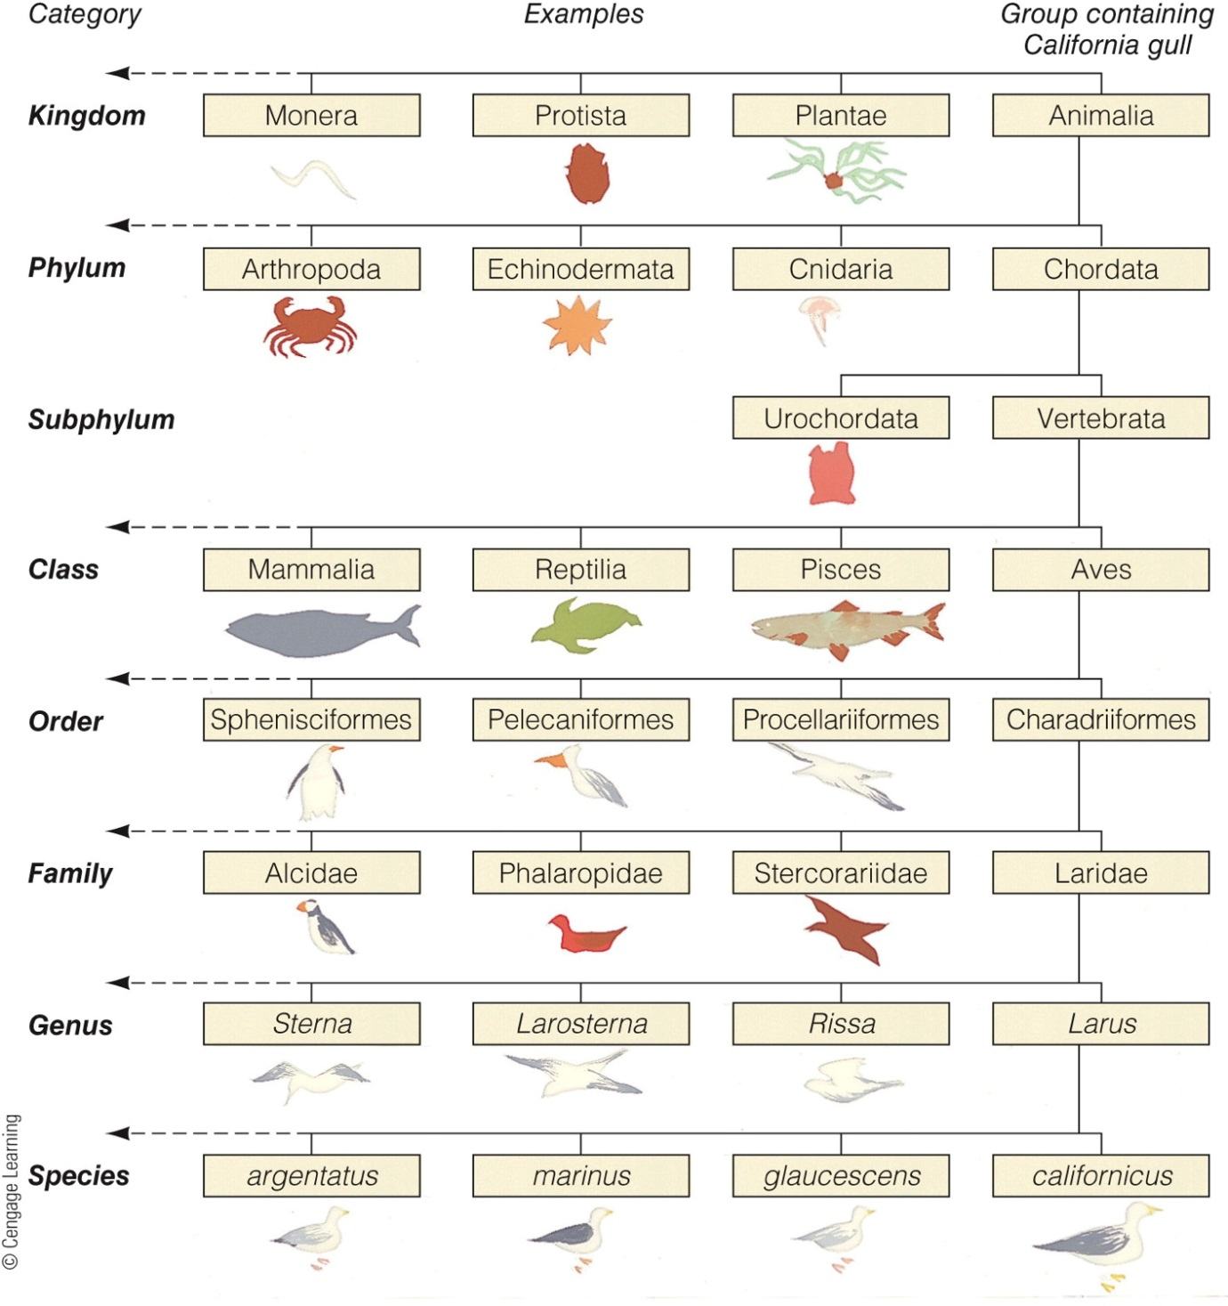
Notes:
Figure 12.7 The modern system of biological classification using the California gull (Larus californicus) as an example. Note the boxes-within-boxes approach—a hierarchy.
© Cengage Learning 2015

Slide 9
The Flow of Energy Allows Living Things to Maintain Complex Organization
The sun is the main source of energy for living things on Earth
Photosynthesis: the process used by most producers to convert the sun’s energy to food energy
Chemosynthesis: the biological conversion of simple carbon molecules into carbohydrate using the oxidation of inorganic molecules as an energy source

Slide 10
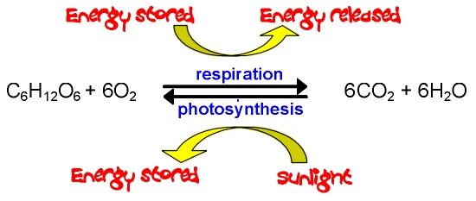
Photosynthesis
Notes:
Figure 12.9 Photosynthesis and chemosynthesis.
a) In photosynthesis, energy from sunlight is used to bond six separate carbon atoms (derived from carbon dioxide) into a single energy-rich six-carbon molecule—the sugar glucose—here represented as (CH2O)x. The pigment chlorophyll absorbs and briefly stores the light energy needed to drive the reactions. Water is broken down in the process, and oxygen is released.
© Cengage Learning 2015

Slide 11
Chemosynthesis
Notes:
Figure 12.9 Photosynthesis and chemosynthesis.
b) A form of chemosynthesis. In this example, 6 molecules of carbon dioxide combine with 6 molecules of oxygen and 24 molecules of hydrogen sulfide to form glucose—(CH₂O)x. (Other products include molecules of sulfate and water.) The energy to bond carbon atoms into glucose comes from breaking the chemical bonds holding the sulfur and hydrogen atoms together in hydrogen sulfide.
© Cengage Learning 2015

Slide 12
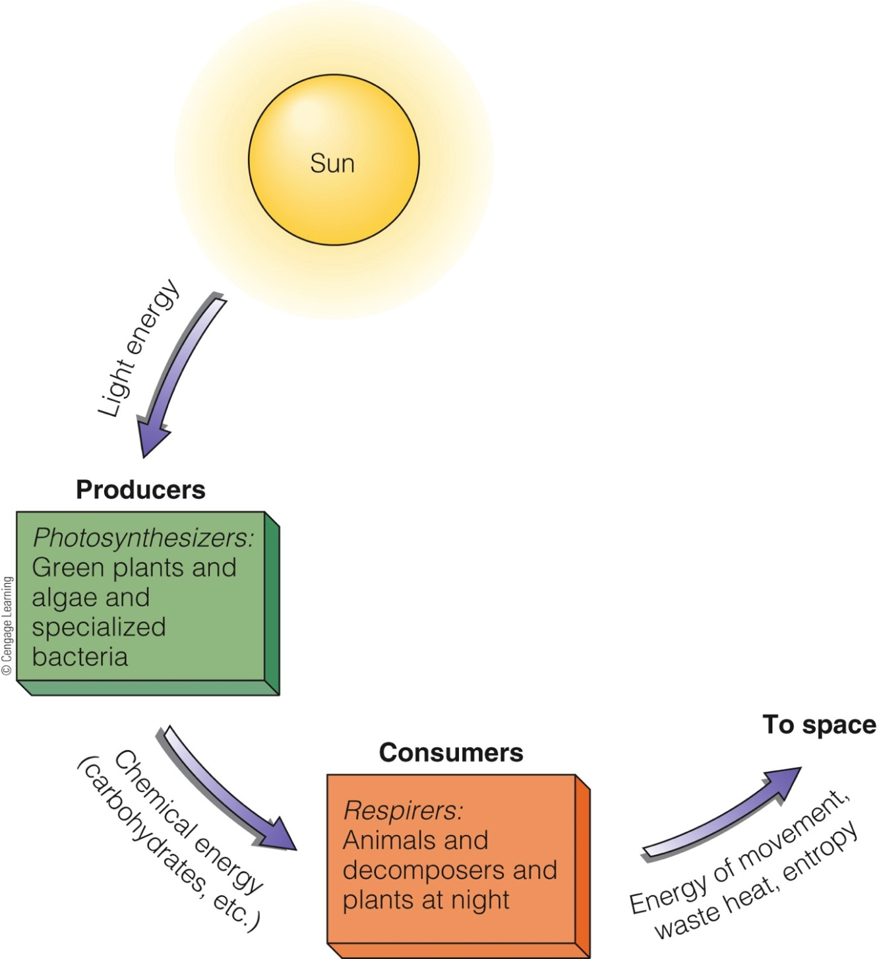
Notes:
Figure 12.10 The flow of energy through living systems. At each step, energy is degraded (that is, transformed into a less useful form).
© Cengage Learning 2015

Slide 13
Primary Producers Synthesize Organic Materials
Primary productivity is expressed in grams of carbon bound into organic material per square meter of ocean surface per year
Phytoplankton
Product 90 to 96 percent of the surface ocean’s carbohydrates
Occurs in water, in seabed sediments, and in solid rock
Extremophiles: bacteria and archaea that live under extreme conditions
Notes:
Plants, Algae, protists (phytoplankton and photosynthetic bacteria)

Slide 14
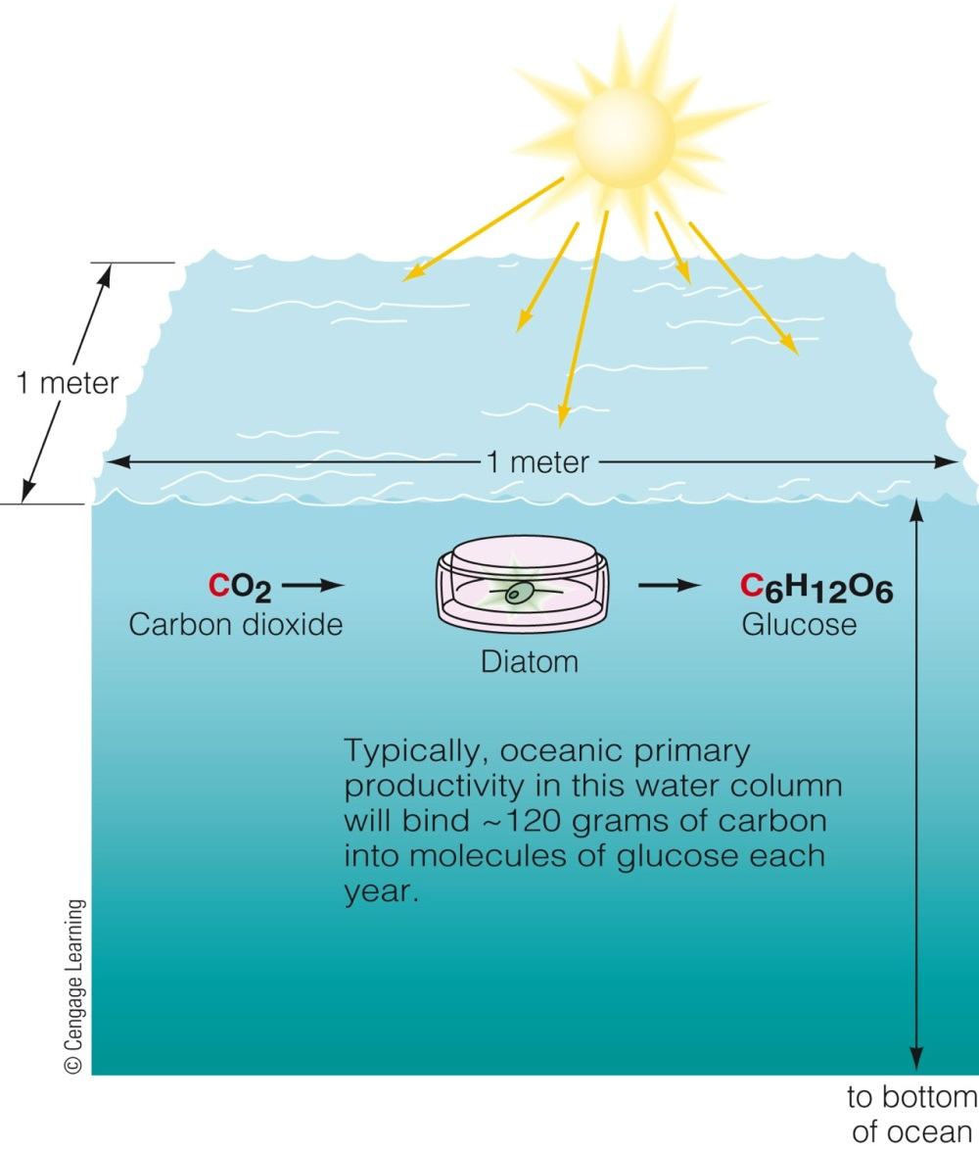
Primary Producers Synthesize Organic Materials (cont’d.)
Notes:
Figure 12.11 Expressions of oceanic productivity.
a) Oceanic productivity—the incorporation of carbon atoms into carbohydrates—is measured in grams of carbon bound into carbohydrates per square meter of ocean surface area per year (gC/m2/yr).
© Cengage Learning 2015

Slide 15
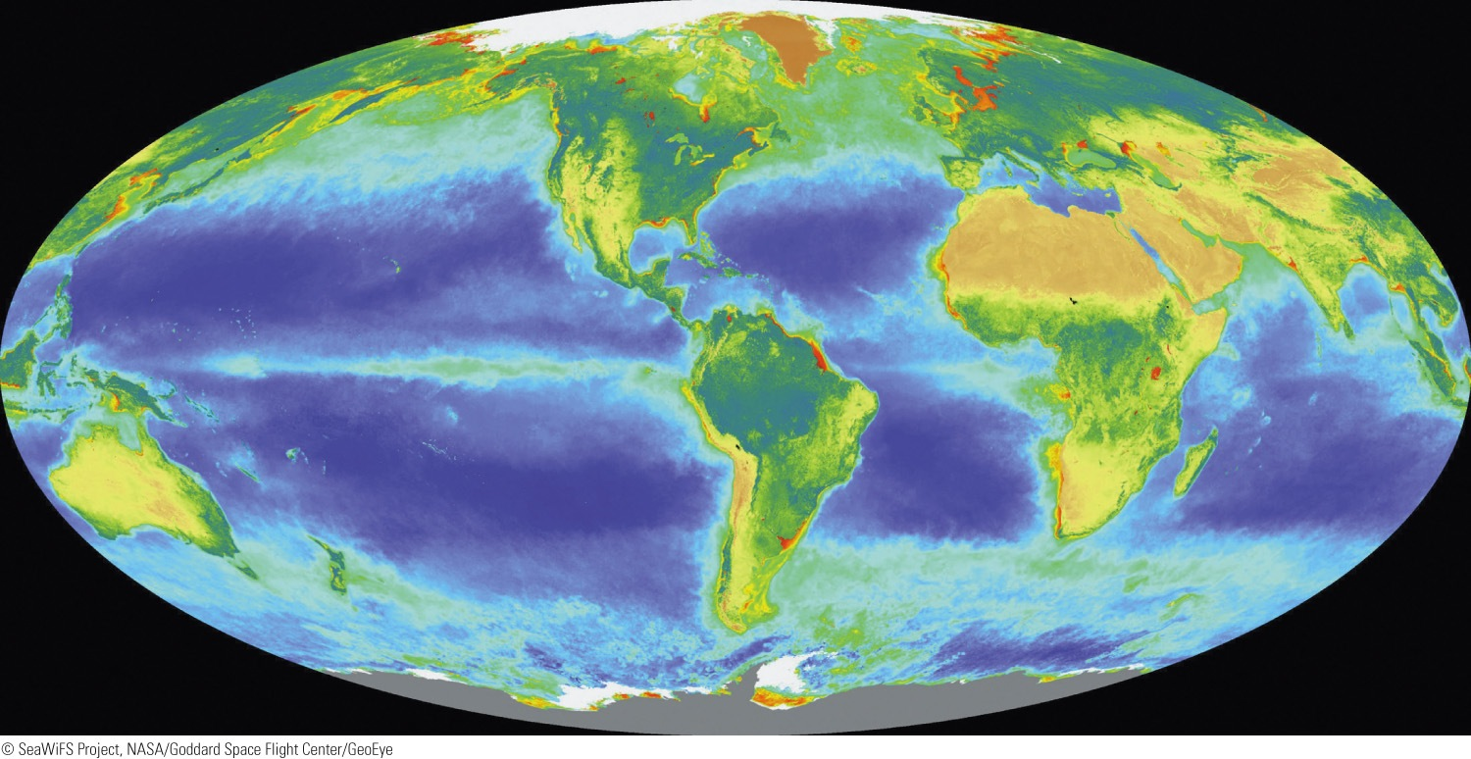
Primary Productivity in the Ocean
High primary productivity: red, yellow, and green areas
Low primary productivity: blue areas
Notes:
Figure 12.12 Oceanic productivity can be observed from space. NASA’s SeaWiFS satellite, launched in 1997, can detect the amount of chlorophyll in ocean surface water. Chlorophyll content provides an estimate of productivity. Red, yellow, and green areas indicate high primary productivity; blue areas indicate low productivity. This image was derived from measurements made between September 1997 and August 1998.

Slide 16
Food Webs Disperse Energy through Communities
Autotrophs (producers): organisms that make their own food
Heterotrophs: organisms that must consume other organisms for energy
Trophic pyramid: a model that describes who eats whom

Slide 17
Food Webs Disperse Energy through Communities (cont’d.)
Primary consumers (herbivores): organisms that eat producers
Secondary consumers (carnivores): organisms that eat primary consumers
Top consumer (top carnivore)
Found at the top of the trophic pyramid

Slide 18
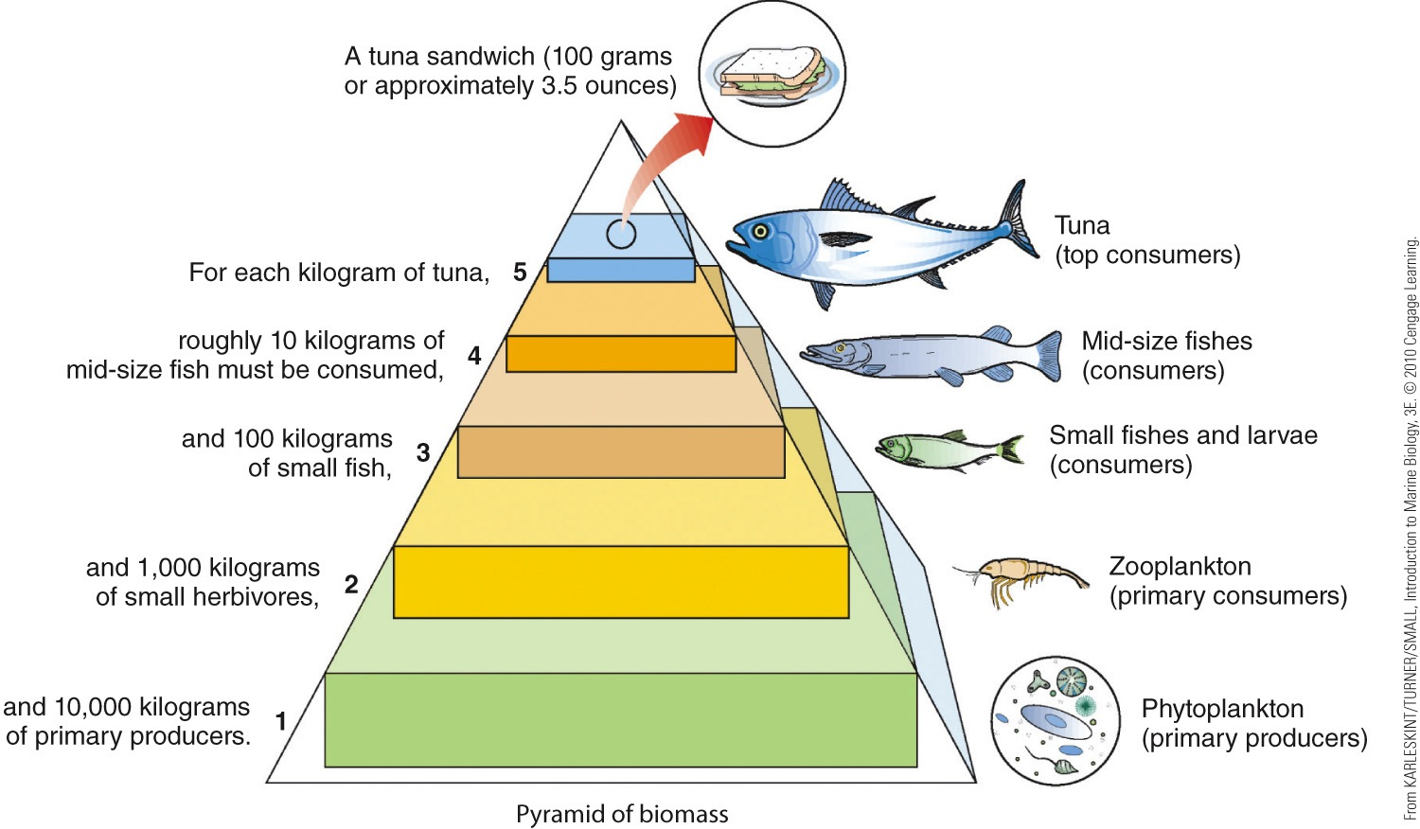
Notes:
Figure 12.14 generalized trophic pyramid. How many kilograms of primary producers are necessary to maintain 1 kilogram of tuna, a top carnivore? What is required for an average tuna sandwich? Using the trophic pyramid model shown here, you can see that 1 kilogram of tuna at the fifth trophic level (the fifth feeding step of the pyramid) is supported by 10 kilograms of midsize fish at the fourth, which, in turn, is supported by 100 kilograms of small fish at the third, which have fed on 1,000 kilograms of zooplankton (primary consumers) at the second, which have eaten 10,000 kilograms of phytoplankton (small autotrophs, primary producers) at the first. The quarter-pound tuna sandwich has a long and energetic history. (These figures have been rounded off to illustrate the general principle. The actual measurements are difficult to make and quite variable.)
© Cengage Learning 2015

Slide 19
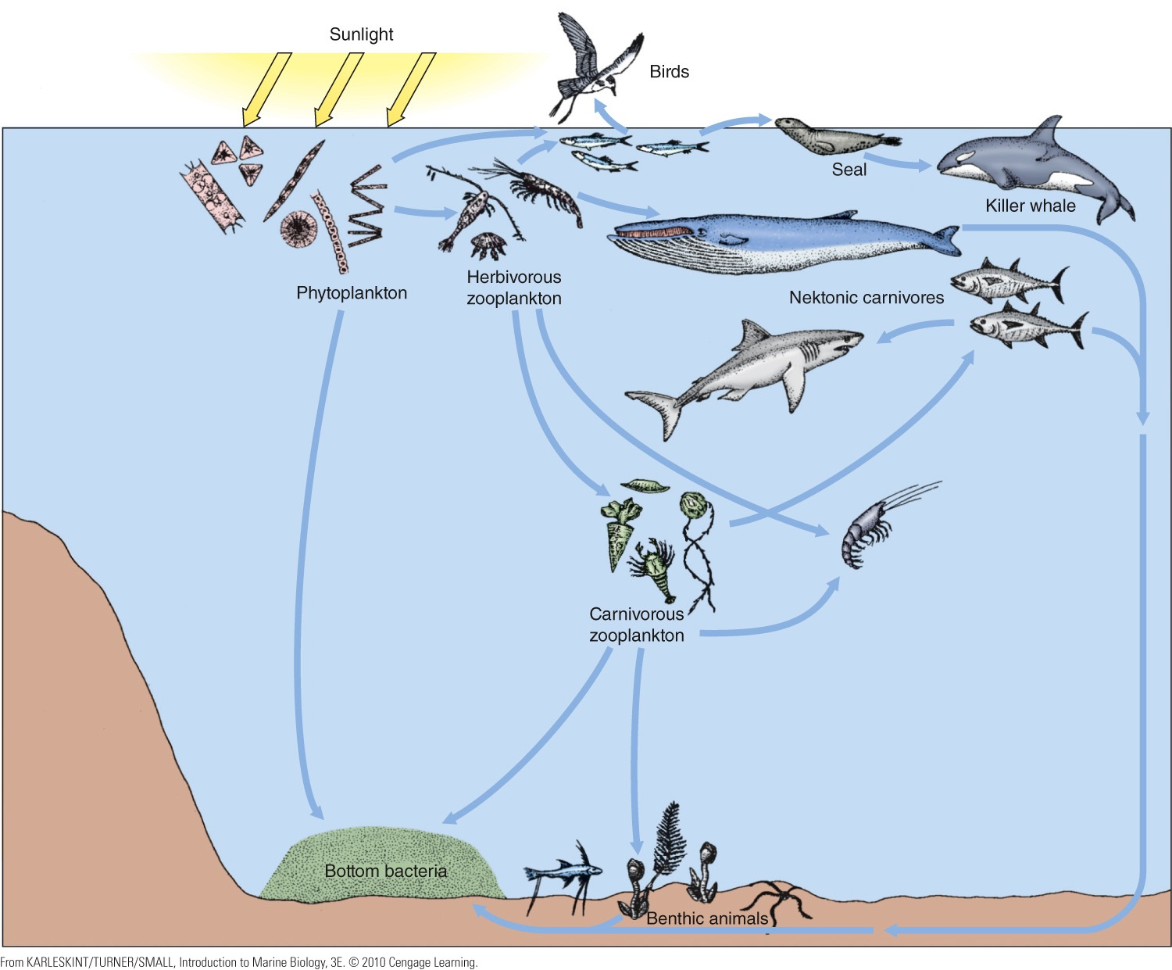
Notes:
Figure 12.15 A simplified food web, illustrating the major trophic relations leading to an adult killer whale. The arrows show the direction of energy flow; the number on each arrow represents the trophic level at which the organism is feeding. Note that feeding relations are not as simple as one might assume from Figure 12.14.
© Cengage Learning 2015

Slide 20
Environmental Factors Influence the Success of Marine Organisms
Any aspect of the physical environment that affects organisms is a physical factor
Light, dissolved gases, temperature, dissolved nutrients, acid-base balance, salinity, and hydrostatic pressure
Biological factors affecting living organisms
Diffusion, osmosis, active transport, and surface-to-volume ratio

Slide 21
Environmental Factors Influence the Success of Marine Organisms (cont’d.)
Limiting factor: a factor found in the environment that can be harmful if present in quantities that are too large or too small

Slide 22
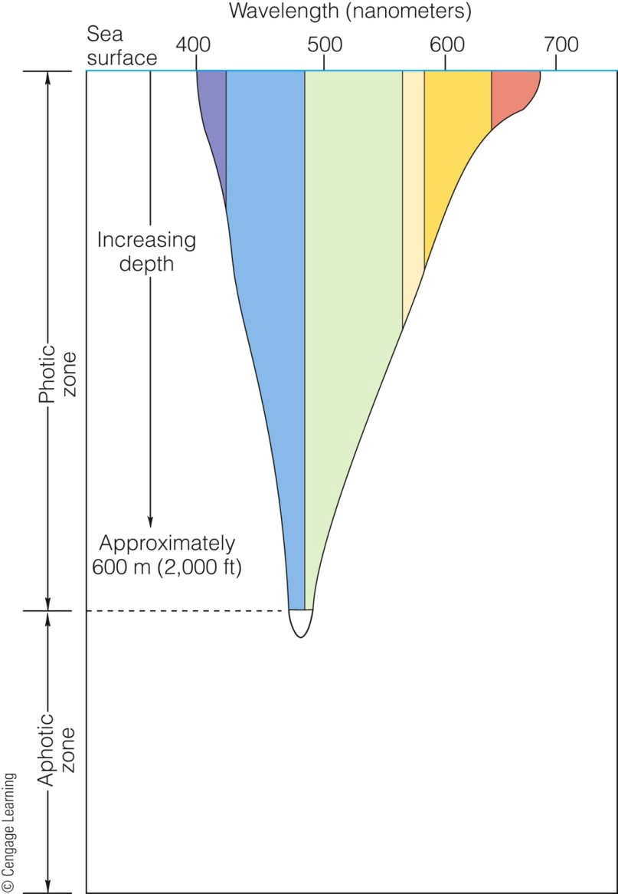
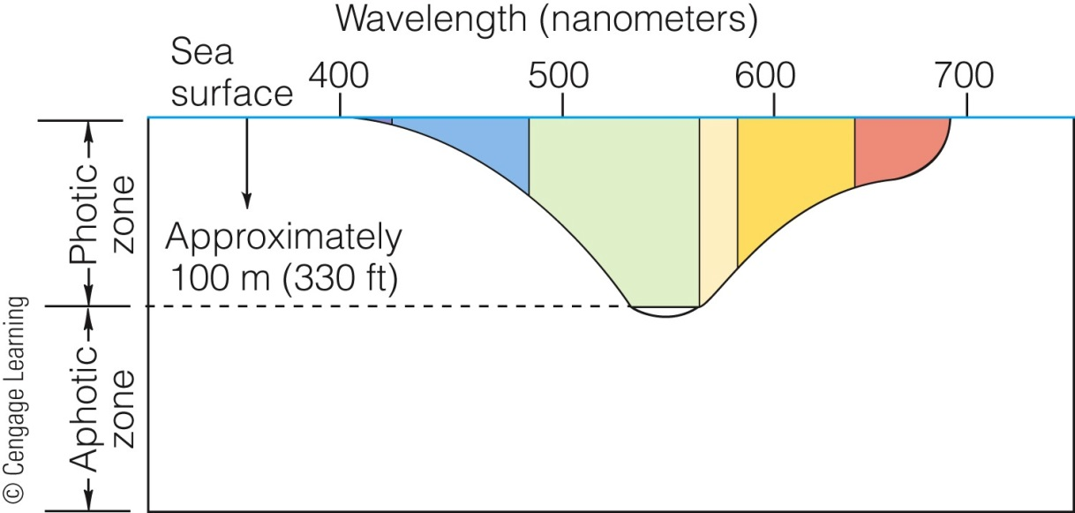
(a) Clear, open ocean water
(b) Coastal ocean water
Notes:
Figure 12.1 Penetration of light into the ocean.
a) Clear, open ocean water
In clear, open ocean water, sensitive instruments can detect light to a depth of 600 meters (2,000 feet).
b) Coastal ocean water
Because of the suspended particles often present in coastal waters, light cannot penetrate so far—about 100 meters (330 feet) is typical. The sunlit upper zone is called the photic zone. The dark ocean beneath is called the aphotic zone.
© Cengage Learning 2015

Slide 23
Photosynthesis Depends on Light
Euphotic zone: area near the surface where most of the ocean’s biological productivity occurs
Disphotic zone: below the euphotic zone lies
Aphotic zone: dark, vast bulk of the ocean where sunlight never reaches
Below the disphotic zone

Slide 24
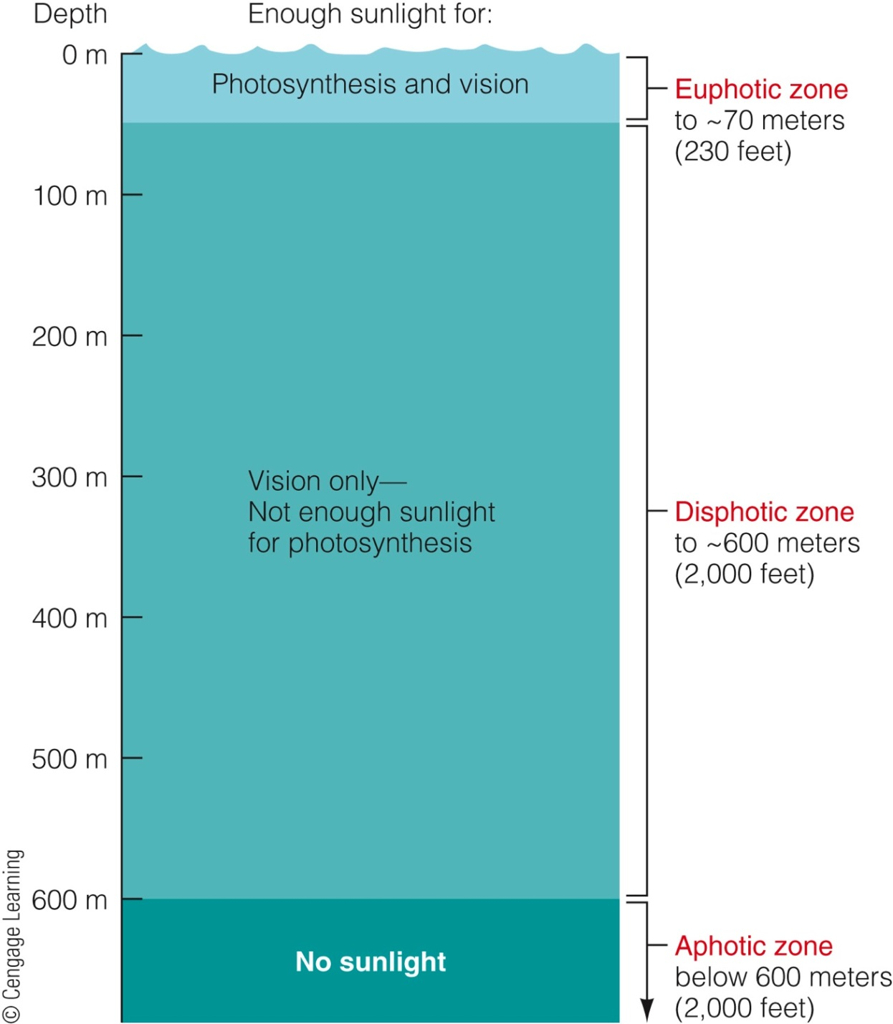
Notes:
Figure 12.17 The upper, sunlit zone of the ocean is known as the photic zone. In the euphotic zone, there is enough light for photosynthesis. Below that depth, in the disphotic zone, light may be present, but not in adequate quantity for the photosynthetic production of glucose to exceed its consumption. The aphotic zone lies in permanent darkness. Most of the ocean is without sunlight all of the time, and all of it is dark some of the time.
© Cengage Learning 2015

Slide 25
Temperature Influences Metabolic Rate
Metabolic rate increases with temperature
Ectothermic: “cold blooded
Organisms with internal temperatures that stay very close to that of the surroundings
Most marine organisms
Endothermic: “warm blooded”
Complex animals that have a stable, high internal temperature
Mammals, birds, and a few fishes
Notes:
Figure 12.18 Temperatures of marine waters capable of supporting life. Some isolated areas of the ocean, notably within and beneath hydrothermal vents, may support specialized living organisms at temperatures to 400°C (750°F)

Slide 26
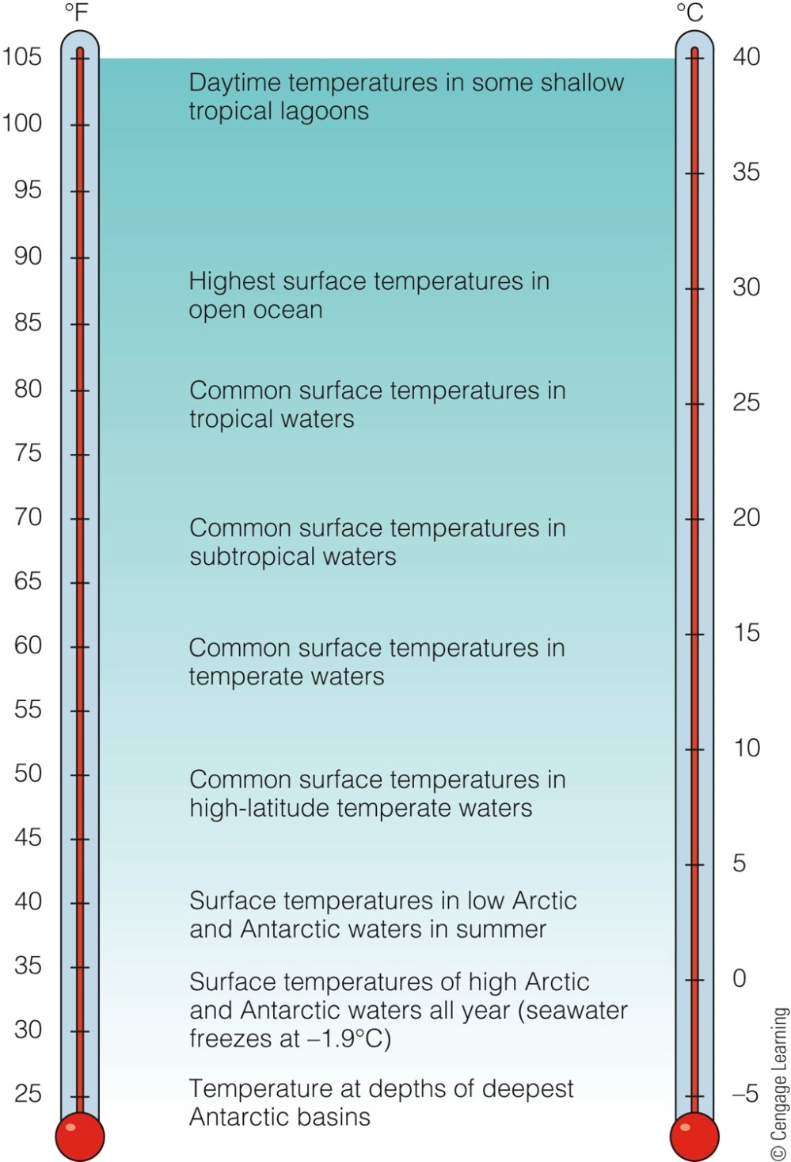
Notes:
Figure 12.18 Temperatures of marine waters capable of supporting life. Some isolated areas of the ocean, notably within and beneath hydrothermal vents, may support specialized living organisms at temperatures to 400°C (750°F)!
© Cengage Learning 2015

Slide 27
Substances Move Through Cells by Diffusion, Osmosis, and Active Transport
Diffusion: mixing due to random molecular movements
Osmosis: diffusion of water through a membrane
Isotonic: same concentration of dissolved substances inside/outside the organism
Hypertonic
Hypotonic

Slide 28
Diffusion, Osmosis, and Active Transport (cont’d.)
Active transport: the transport of a substance against a concentration gradient
Requires energy input

Slide 29
An Example of Diffusion
Notes:
Figure 12.20 An example of diffusion. Molecules of dye gradually diffuse through the surrounding water as a dye cube dissolves. Random molecular movement spreads the dye away from the region of high concentration at the cube’s surface. At the same time, water moves from its own region of high concentration (next to the dye cube) to areas of lower concentration (within the disintegrating dye cube itself). After many days, dye will be distributed evenly throughout the water. Stirring would greatly accelerate the mixing process, but this input of mechanical energy is not required if you don’t mind waiting for diffusion alone to accomplish the task.
© Cengage Learning 2015

Slide 30
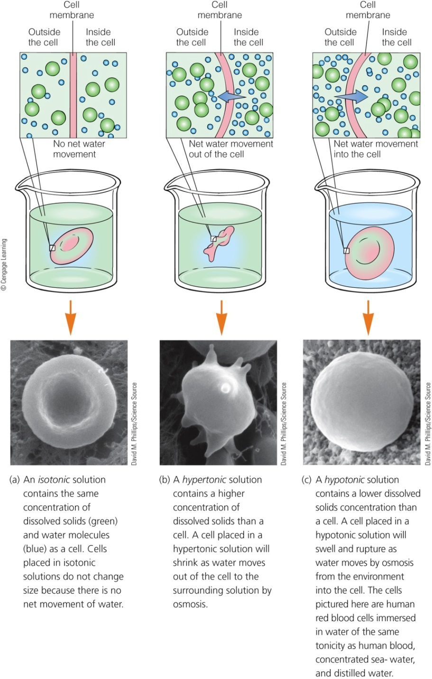
Notes:
Figure 12.21 Effects of osmosis in different environments.
a) An isotonic solution contains the same concentration of dissolved solids (green) and water molecules (blue) as a cell. Cells placed in isotonic solutions do not change size because there is no net movement of water.
b) A hypertonic solution contains a higher concentration of dissolved solids than a cell. A cell placed in a hypertonic solution will shrink as water moves out of the cell to the surrounding solution by osmosis.
c) A hypotonic solution contains a lower dissolved solids concentration than a cell. A cell placed in a hypotonic solution will swell and rupture as water moves by osmosis from the environment into the cell. The cells pictured here are human red blood cells immersed in water of the same tonicity as human blood.
© Cengage Learning 2015
Photos courtesy of David M. Phillips/Science Source

