Slide 1
Marine Productivity

Slide 2
Productivity varies greatly in different parts of the ocean
10-2
Depends on:
Availability of nutrients
sunlight
In the tropics and subtropics sunlight is abundant, but has restricted upwelling of nutrients and results in lower productivity.
High productivity locally can occur in areas of coastal upwelling, in the tropical waters between the gyres and at coral reefs.

Slide 3
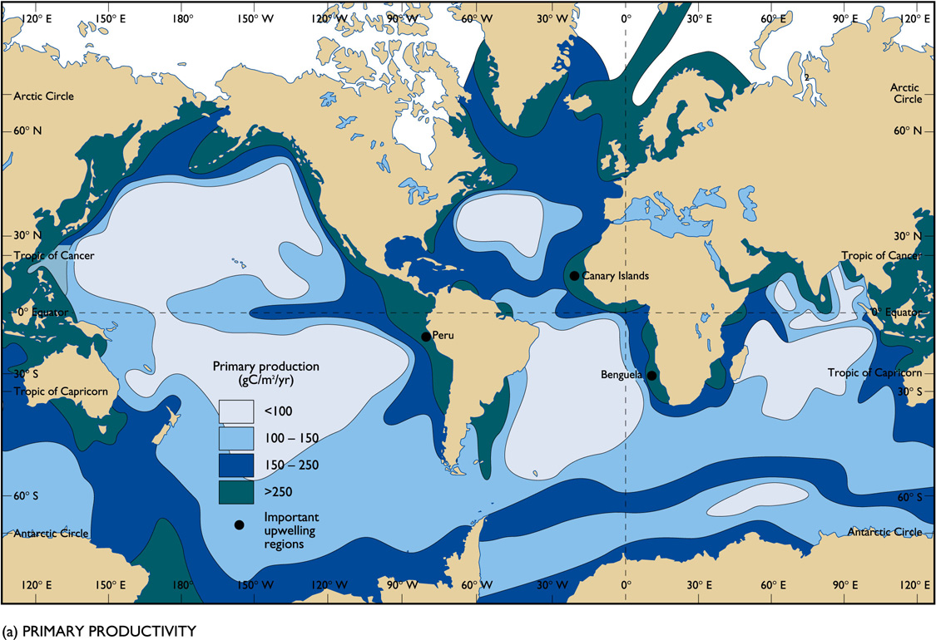

Slide 4
Upwelling of deep, nutrient-rich water supports large populations of phytoplankton and fish.
10-4
Biological Productivity of Upwelling Water
Peru→ normally is an area of upwelling, supporting one of the world’s largest fisheries.
Every three to seven years warm surface waters in the Pacific displace the cold, nutrient-rich water on Peru’s shelf in a phenomenon called El Nino.
El Nino results in a major change in fauna on the shelf and a great reduction in fishes.
This can lead to mass starvation of organisms dependent upon the fish as their major food source.

Slide 5
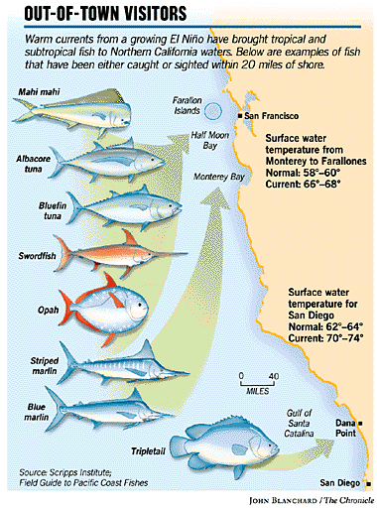

Slide 6
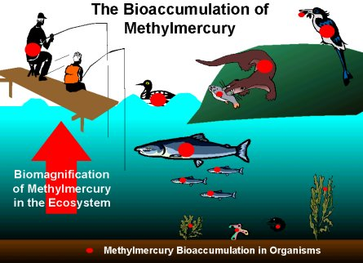
Toxins in Marine Organisms
Bioaccumulation:
refers to the accumulation of chemicals in an organism

Slide 7
Sources of Pollutants
Mercury
Hatting industry in CT→ Mad Hatter’s disease
Power plants
Polychlorinated biphenyls (PCB’s)
Coolant used in manufacturing electrical components
Persistent organic pollutant
Endocrine disruptor

Slide 8
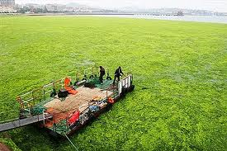
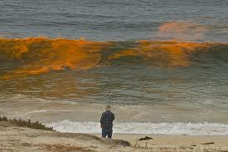
Algae blooms
Eutrophication:
Addition of artificial substances fertilizer/sewage (nitrogen, phosphorous) to an aquatic ecosystem
Causes algae blooms

Slide 9
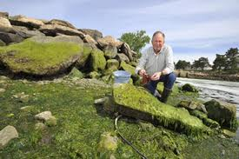
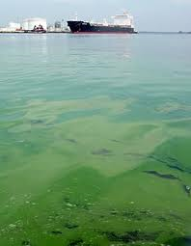
Lack of oxygen
Aquatic organisms die, water changes color, health problems

Slide 10
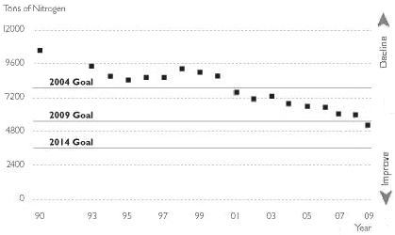
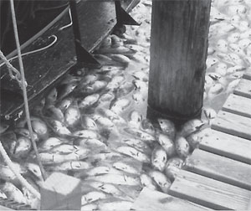
Nitrogen in Long Island Sound
Hypoxia:
Oxygen levels are too low to support life
Excess nitrogen stimulates growth of aquatic plants→ die →consumed by oxygen-using bacteria

Slide 11
Hypoxia
Seasonal process
Does not occur each year
Influenced by temperature, nitrogen input, weather

Slide 12
Sources
Nitrogen enters the LIS watershed through:
sewage- failing septic systems, CSO’s, wastewater treatment facilities
Fertilizer- runoff

Slide 13
LIS 2002

Slide 14
LIS 2012

